Slide 1
Sw. Evolution Standards & Models Explained
D. A. Tamburri, Ph.D.
Notes:
Handouts
------------------------------------------------------------------
------------------------------------------------------------------
-------------------------------------------------------------------
--------------------------------------------------------------------

Slide 2


Slide 3
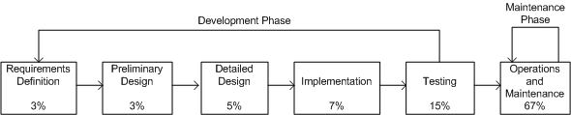
General Idea*
One traditional software development life cycle (SDLC) is shown in the Figure below, which comprises two discrete phases, namely:
  development and
  maintenance
Maintenance equating to ca. 2/3 of the product life-span.
The percentages in the figure indicate relative costs.
*Traditional SDLC model ©Wiley, 1988
Notes:
Handouts

Slide 4
General Idea
Software maintenance has unique characteristics:
Constraints of an existing system: Maintenance is performed on an operational system. Therefore, all modifications must be compatible with the constraints of the existing architecture, design, and code.
Shorter time frame: A maintenance activity may span from a few hours to a few months, whereas software development may span one or more years.
Available test data: In software development, test cases are designed from scratch, whereas software maintenance can select a subset of these test cases and execute them as regression tests.
Software maintenance should have its own Software Maintenance Life Cycle (SMLC) model as it involves many unique activities.
Notes:
Handouts

Slide 5
Reuse Oriented Models
One obtains a new version of an old system by modifying one or several components of the old system and possibly adding new components.
Based on this concept, three process models for maintenance have been proposed by Basili:
  Quick fix model: In this model, necessary changes are quickly made to the code and then to the accompanying documentation.
  Iterative enhancement model: In this model, first changes are made to the highest-level documents. Eventually, changes are propagated down to the code level.
  Full reuse model: In this model, a new system is built from components of the old system and others available in the repository.
Notes:
Handouts

Slide 6
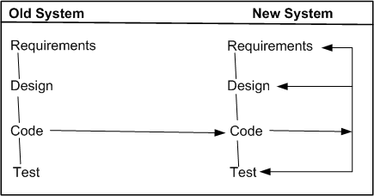
Reuse Oriented Models
In Quick-Fix Model, as illustrated in the Figure below
source code is modified to fix the problem;
necessary changes are made to the relevant documents; and
the new code is recompiled to produce a new version.
Often changes to the source code are made with no prior investigation such as analysis of impact of the changes, ripple effects of the changes, and regression testing.
The quick fix model ©IEEE, 1990
Notes:
Handouts

Slide 7
Reuse Oriented Models
Iterative Vs. Incremental
The terms iteration and increment are liberally used when discussing iterative and incremental development.
However, they are not synonyms in the field of software engineering.
Iteration implies that a process is basically cyclic, thereby meaning that the activities of the process are repeatedly executed in a structured manner.
Iterative development is based on scheduling strategies in which time is set aside to improve and revise parts of the system under development.
Incremental development is based on staging and scheduling strategies in which parts of the system are developed at different times and/or paces, and integrated as they are completed.
Notes:
Handouts

Slide 8
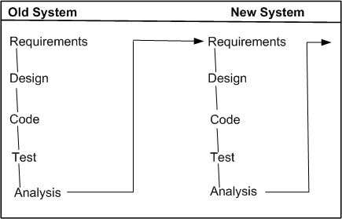
Reuse Oriented Models
The iterative enhancement model, explained in the Figure below, shows how changes flow from the very top-level documents to the lowest-level documents.
The model works as follows:
It begins with the existing system’s artifacts, namely, requirements, design, code, test, and analysis documents.
It revises the highest-level documents affected by the changes and propagates the changes down through the lower-level documents.
The model allows maintainers to redesign the system, based on the analysis of the existing system.
The iterative enhancement model ©IEEE, 1990
Notes:
Handouts

Slide 9
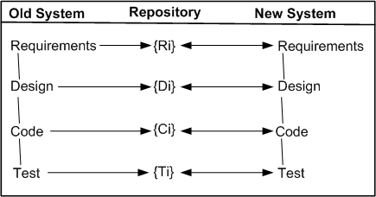
Reuse Oriented Models
The main assumption in this model is the availability of a repository of artifacts describing the earlier versions of the systems.
In the full reuse model, reuse is explicit, and the following activities are performed:
  identify the components of the old system that are candidates for reuse
  understand the identified system components.
  modify the old system components to support the new requirements.
  integrate the modified components to form the newly developed system.
The full reuse model ©IEEE, 1990
Notes:
Handouts

Slide 10
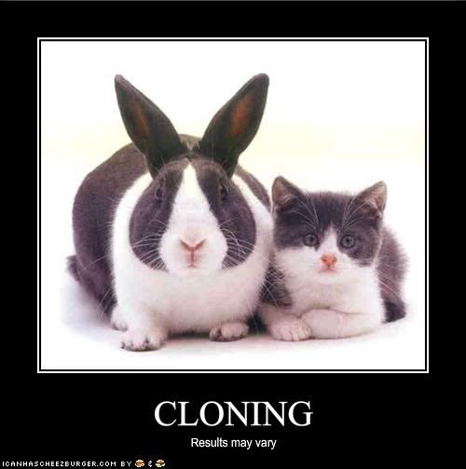
Reuse Oriented Models
The main assumption in this model is the availability of a repository of artifacts describing the earlier versions of the systems.
In the full reuse model, reuse is explicit, and the following activities are performed:
  identify the components of the old system that are candidates for reuse
  understand the identified system components.
  modify the old system components to support the new requirements.
  integrate the modified components to form the newly developed system.
The full reuse model ©IEEE, 1990
Notes:
Handouts

Slide 11
The Staged Model for M&E
Rajlich and Bennett have presented a descriptive model of software evolution called the staged model of maintenance and evolution.
Its primary objective is at improving understanding of how long-lived software evolves, rather than aiding in its management.
Their model divides the lifespan of a typical system into four stages:
  Initial development – The first delivered version is produced. Knowledge about the system is fresh and constantly changing. In fact, change is the rule rather than the exception. Eventually, an architecture emerge and stabilizes.
  Evolution – Simple changes are easily performed, and more major changes are possible too, albeit the cost and risk are now greater than in the previous stage. Knowledge about the system is still good, although many of the original developers will have moved on. For many systems, most of its lifespan is spent in this phase.
  Servicing – The system is no longer a key asset for the developers, who concentrate mainly on maintenance tasks rather than architectural or functional change. Knowledge about the system has lessened and the effects of change have become harder to predict. The costs and risks of change have increased significantly.
  Phase out – It has been decided to replace or eliminate the system entirely, either because the costs of maintaining the old system have become prohibitive or because there is a newer solution waiting in the pipeline. An exit strategy is devised and implemented, often involving techniques such as wrapping and data migration. Ultimately, the system is shut down.
Notes:
Handouts

Slide 12
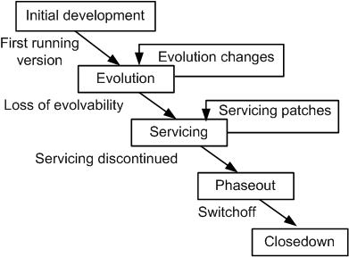
The Staged Model for M&E
The simple staged model for the CSS life cycle ©IEEE, 2000
Notes:
Handouts

Slide 13
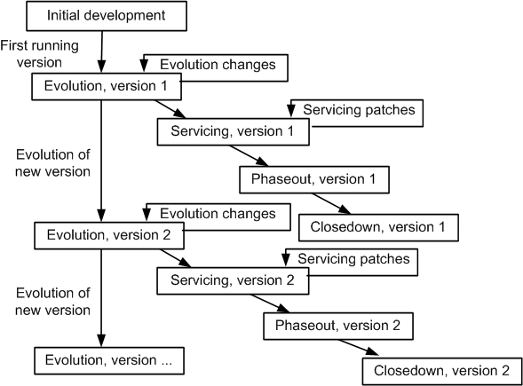
The Staged Model for M&E
The evolution process is the backbone of the model.
The versioned staged model for the CSS life cycle ©IEEE, 2000
Notes:
Handouts

Slide 14
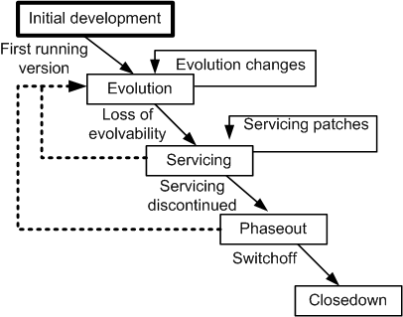
The Staged Model: the FLOSS Example
Three major differences are identified between CSS systems and FLOSS systems.
In the Figure below, the rectangle with the label “Initial development” has been visually highlighted because it can be the only initial development stage in the evolution of FLOSS systems. In other words, it does not have any evolution track for FLOSS system.
With some systems that were analyzed, after a transition from Evolution to Servicing, a new period of evolution was observed. This possibility is depicted in Figure as a broken arc from the Servicing stage to the Evolution stage.
In general, the active developers of FLOSS systems get frequently replaced by new developers. Therefore, the dashed line in Figure exhibits this possibility of a transition from Phaseout stage to Evolution stage.
The staged model for FLOSS system ©ACM, 2007
Notes:
Handouts

Slide 15
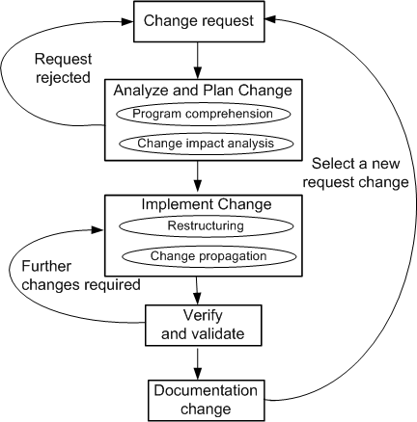
Change Mini-Cycle Model
Software change is a process that may introduce new requirements to the existing system or may need to alter the software system if requirements are not correctly implemented. To capture this, an evolutionary model known as change mini-cycle was proposed by Yau et al. in the late seventies.
The change mini-cycle ©Springer, 2008
Notes:
Handouts

Slide 16
Software Maintenance Standards
IEEE and ISO have both addressed s/w maintenance processes.
IEEE/EIA 1219 and ISO/IEC 14764 as a part of ISO/IEC12207 (life cycle process).
IEEE/EIA 1219 organizes the maintenance process in seven phases:
  problem identification → analysis → design → implementation → system test → acceptance test → delivery.
ISO/IEC 14764 describes s/w maintenance as an iterative process for managing and executing software maintenance activities.
The activities which comprise the maintenance process are:
  process implementation → problem and modification analysis → modification implementation → maintenance review/acceptance → migration → retirement.
Each of these maintenance activity is made up of tasks. Each task describes a specific action with inputs and outputs.
Notes:
Handouts

Slide 17
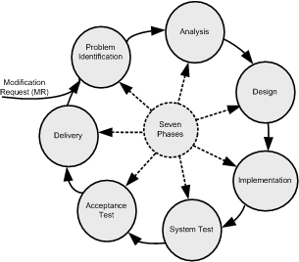
IEEE/EIA 1219 Maintenance Process
The standard focuses on a seven-phases:
Problem Identification.
Analysis.
Design.
Implementation.
System Test.
Acceptance Test.
Delivery.
Seven phases of IEEE maintenance process ©IEEE, 2004
Each of the seven activities has five associated attributes as follows:
Activity definition: This refers to the implementation process of the activity.
Input: This refers to the items that are required as input to the activity.
Output: This refers to the items that are produced by the activity.
Control: This refers to those items that provide control over the activity.
Metrics: This refers to the items that are measured during the execution of the activity.
Notes:
Handouts

Slide 18
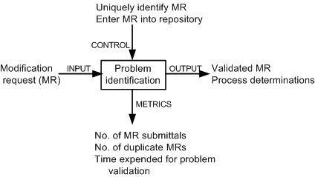
IEEE/EIA 1219 Maintenance Process
Problem identification phase
A request for change to the software is normally made by the users of the software system or the customers, and it starts the maintenance process.
The request for change (CR) is submitted in the form of a modification request (MR) for a correction or for an enhancement. MR & CR are used interchangeably.
Activities included in this phase are as follows:
  reject or accept the MR,
  identify and estimate the resources needed to change the system; and
  put the MR in a batch of changes scheduled for implementation.
Notes:
Handouts

Slide 19
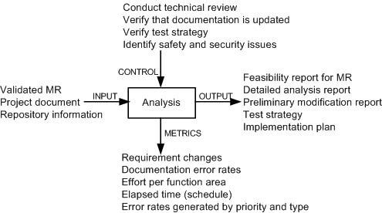
IEEE/EIA 1219 Maintenance Process
Analysis phase
The process is viewed to have two major components:
(i) feasibility analysis.
(ii) detailed analysis.
First, feasibility analysis is performed to: (i) determine the impact of the change; (ii) investigate other possible solutions including prototyping; (iii) assess both short-term and long-term costs; and (iv) determine the benefits of making the change.
The second phase identifies: (i) firm modification requirements; (ii) the software components involved; (iii) an overall test strategy; and (iv) an implementation plan.
Notes:
Handouts

Slide 20
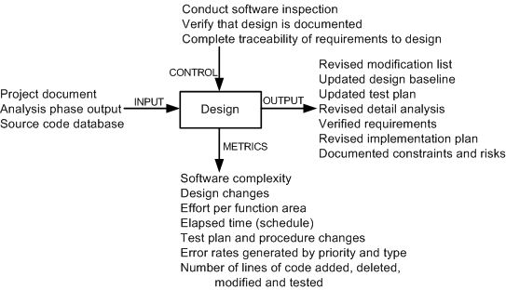
IEEE/EIA 1219 Maintenance Process
Design phase
Activities of this phase are as follows:
  (i) identify the affected software components.
  (ii) modify the software components.
  (iii) document the changes.
  (iv) create a test suite for the new design.
  (v) select test cases for regression testing.
Notes:
Handouts

Slide 21
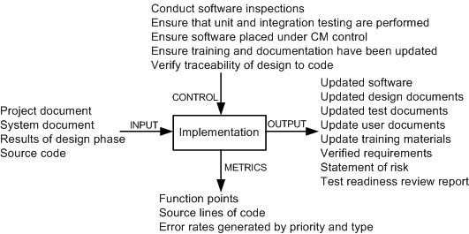
IEEE/EIA 1219 Maintenance Process
  Implementation phase
The activities executed in this phase are:
  writing new code and performing unit testing,
  integrating changed code,
  conducting integration and regression testing,
  performing risk analysis, and
  reviewing the system for test-readiness.
Notes:
Handouts

Slide 22
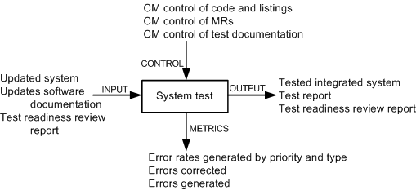
IEEE/EIA 1219 Maintenance Process
System test phase
In this phase tests are performed on the full system to ensure that the modified system complies with the original requirements as well as the new modifications.
System-level testing comprises a broad spectrum of testing activities: functionality testing, robustness testing, stability testing, load testing, performance testing, security testing, and regression testing.
Notes:
Handouts

Slide 23
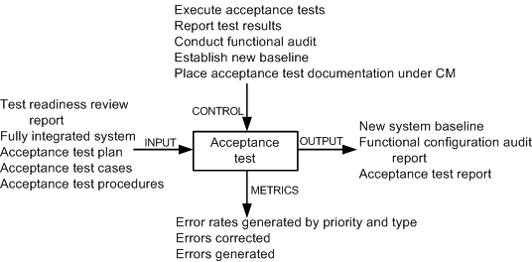
IEEE/EIA 1219 Maintenance Process
Acceptance test phase
Acceptance testing is performed on a completely integrated system, and it involves customers, users, or their representatives.
The main objective of acceptance testing is to assess the overall quality of the system, rather than actively identify defects.
An important concept in acceptance testing is the customer’s expectation from the system.
Notes:
Handouts

Slide 24
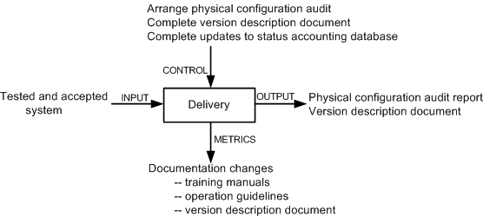
IEEE/EIA 1219 Maintenance Process
Delivery phase
In this phase, the changed system is released to customers for installation and operation.
Included in this phase are the following activities: notify the user community, perform installation and training, and develop an archival version of the system for backup.
Notes:
Handouts

Slide 25
ISO/IEC 14764 Maintenance Process
ISO/IEC 14764 is an international standard for software maintenance.
It describes maintenance using the same concepts as IEEE/EIA 1219 except that they are depicted slightly differently.
The basic structure of an ISO process is made up of activities, and an activity is made up of tasks.
Upon an activation of the maintenance process, plans and procedures are developed and resources are allocated to carry out maintenance.
In response to a change request, code is modified in conjunction with the relevant documentation.
Modification of the running software without losing the system’s integrity is the overall objective of maintenance.
Notes:
Handouts

Slide 26
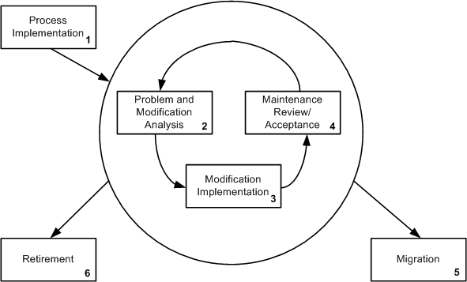
ISO/IEC 14764 Maintenance Process
The maintenance process comprises the following high level activities:
1. Process Implementation.
2. Problem and Modification Analysis.
3. Modification Implementation.
4. Maintenance Review and Acceptance.
5. Migration.
6. Retirement.
ISO/IEC 14764 iterative maintenance process ©IEEE, 2004
Notes:
Handouts

Slide 27
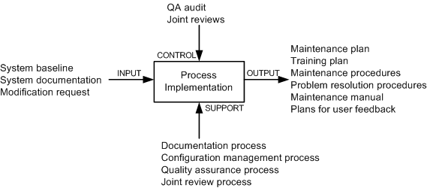
ISO/IEC 14764 Maintenance Process
The process implementation activity consists of three major tasks:
Maintenance plan.
Modification requests (MR/CR).
Configuration management.
Process implementation activity
Notes:
Handouts

Slide 28
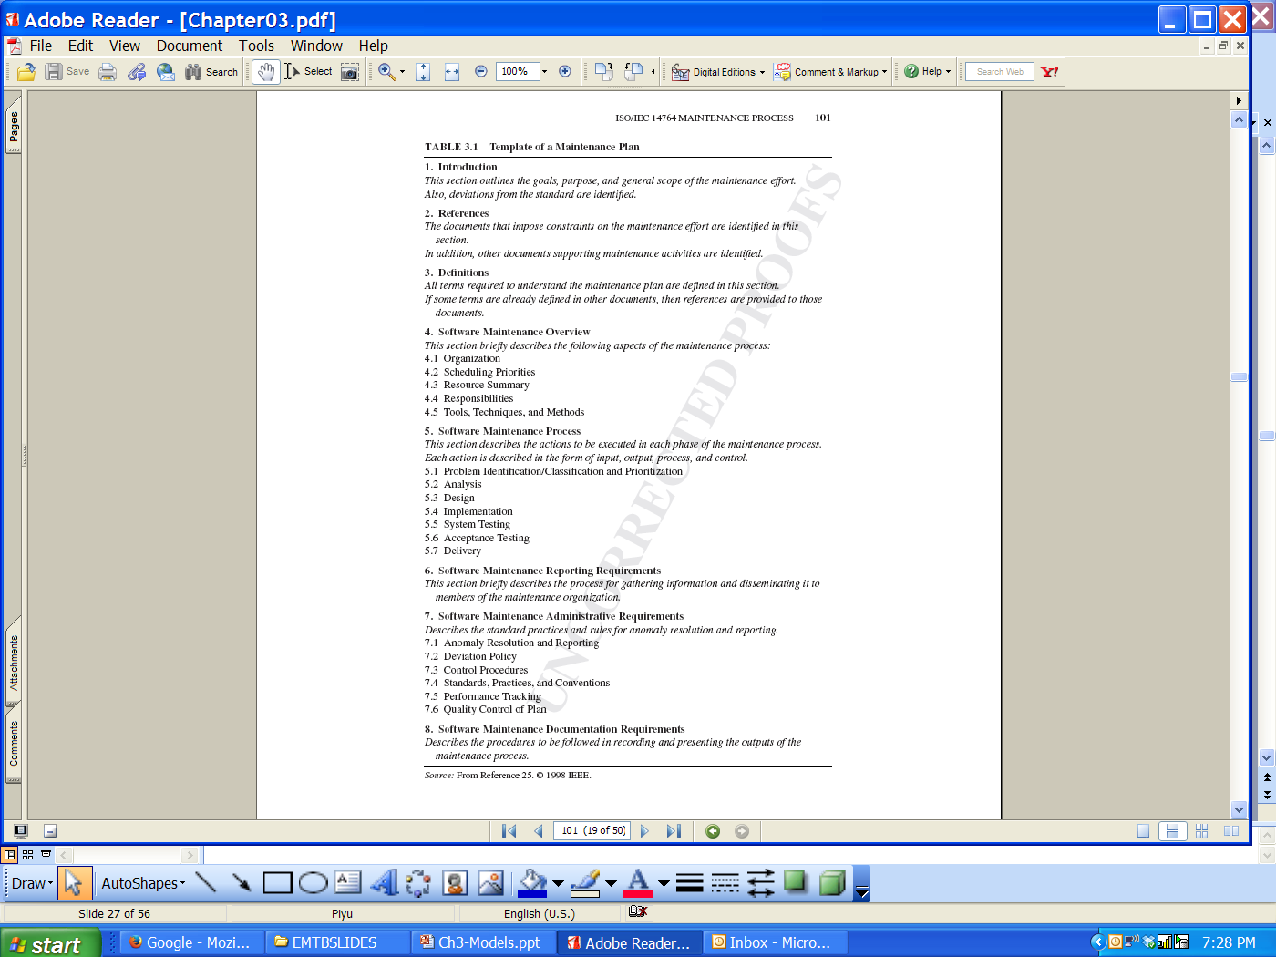
ISO/IEC 14764 Maintenance Process: a template
Notes:
Handouts

Slide 29
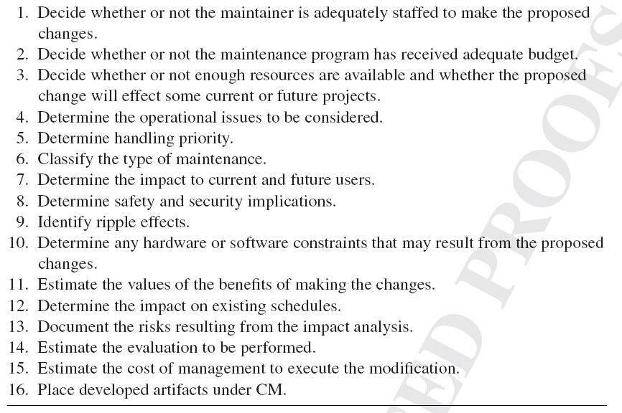
ISO/IEC 14764 maintenance process: steps
Notes:
Handouts

Slide 30
ISO/IEC 14764 maintenance process: steps
Notes:
Handouts

Slide 31
ISO/IEC 14764 maintenance process: steps
resources
issue
constraints
Notes:
Handouts

Slide 32
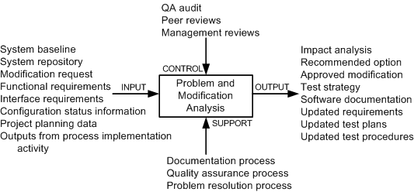
ISO/IEC 14764 Maintenance Process
The problem and modification analysis activity comprises five tasks:
  Modification request analysis.
  Verification.
  Options.
  Documentation.
  Approval.
Problem modification activity
Notes:
Handouts

Slide 33
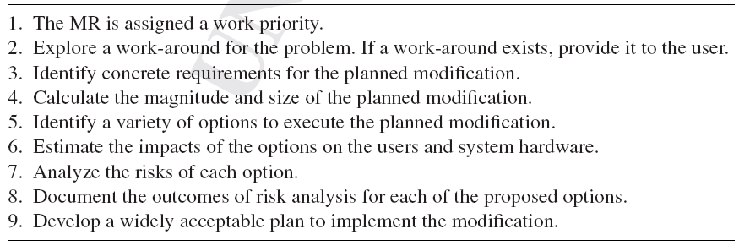
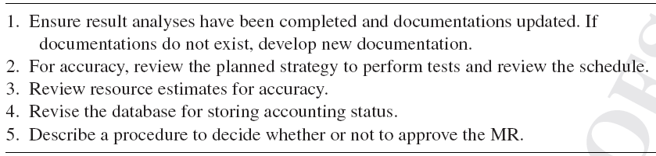
ISO/IEC 14764 Maintenance Process
Notes:
Handouts

Slide 34
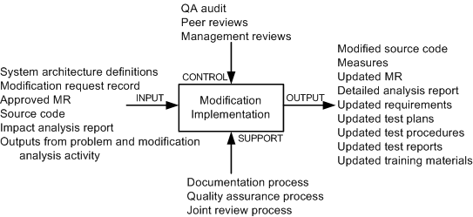
ISO/IEC 14764 Maintenance Process
In this activity, maintainers:
(i) identify the items to be modified, and
(ii) execute a development process to actually implement the modifications.
Modification implementation activity
Notes:
Handouts

Slide 35
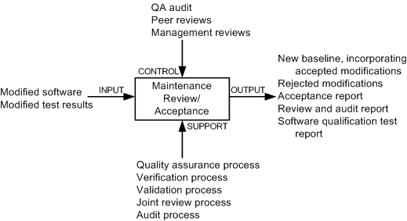
ISO/IEC 14764 Maintenance Process
By means of this activity, it is ensured that:
  (i) the changes made to the software are correct, and
  (ii) changes are made to the software according to accepted standards and methodologies.
The activity is augmented with the following processes:
  (i) a process for quality management,
  (ii) a process to verify the product,
  (iii) a process to validate the product, and
  (iv) a process to review the product.
Maintenance review/acceptance activity
Notes:
Handouts

Slide 36
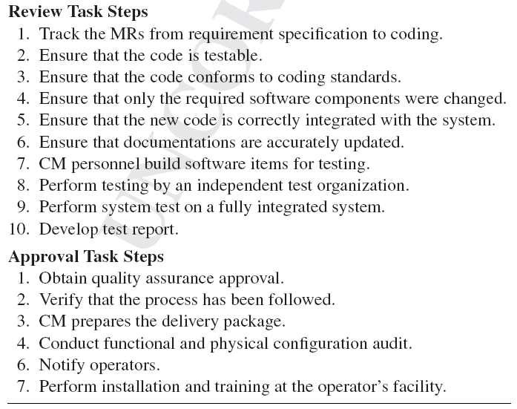
ISO/IEC 14764 Maintenance Process
Notes:
Handouts

Slide 37
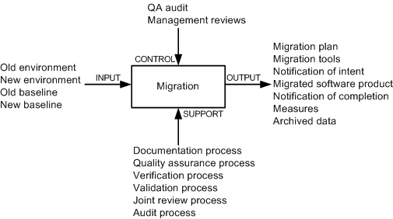
ISO/IEC 14764 Maintenance Process
Migration is effected in two broad phases:
(i) identify the actions required to achieve migration, and
(ii) design and document the concrete steps to be executed to effect migration.
Migration activity
Notes:
Handouts

Slide 38
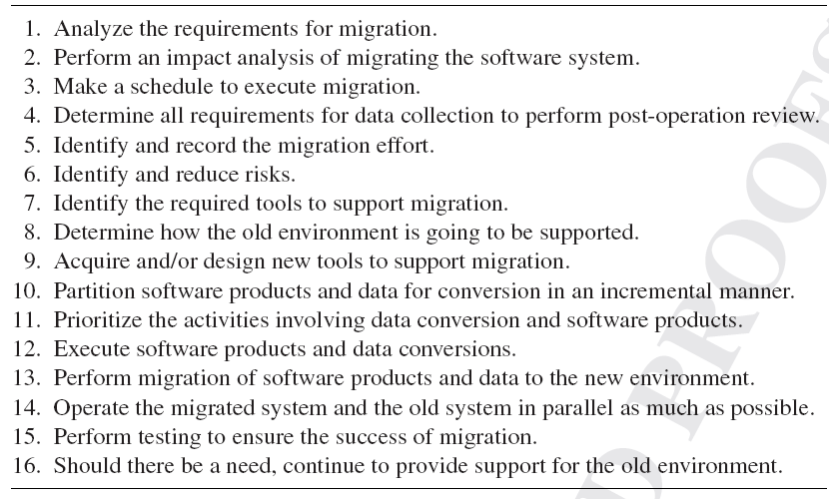
ISO/IEC 14764 Maintenance Process
Notes:
Handouts

Slide 39
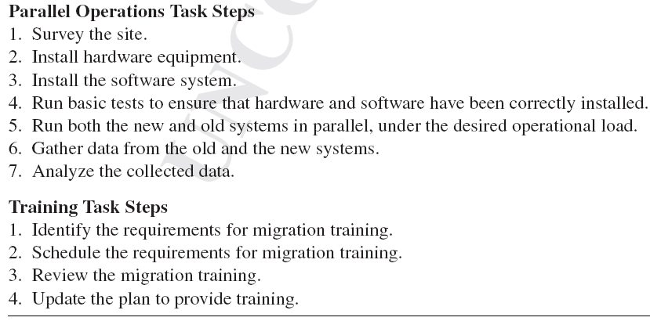
ISO/IEC 14764 Maintenance Process
Notes:
Handouts

Slide 40
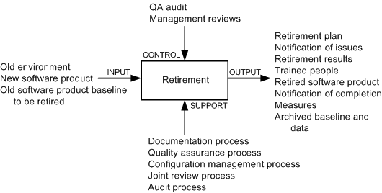
ISO/IEC 14764 Maintenance Process
This activity comprises five tasks:
  Retirement plan
  Notification of intent
  Implement parallel operations and training
  Notification of completion
  Data archival
Retirement activity
Notes:
Handouts

Slide 41
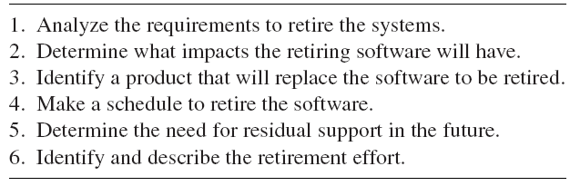
ISO/IEC 14764 Maintenance Process
Notes:
Handouts

Slide 42
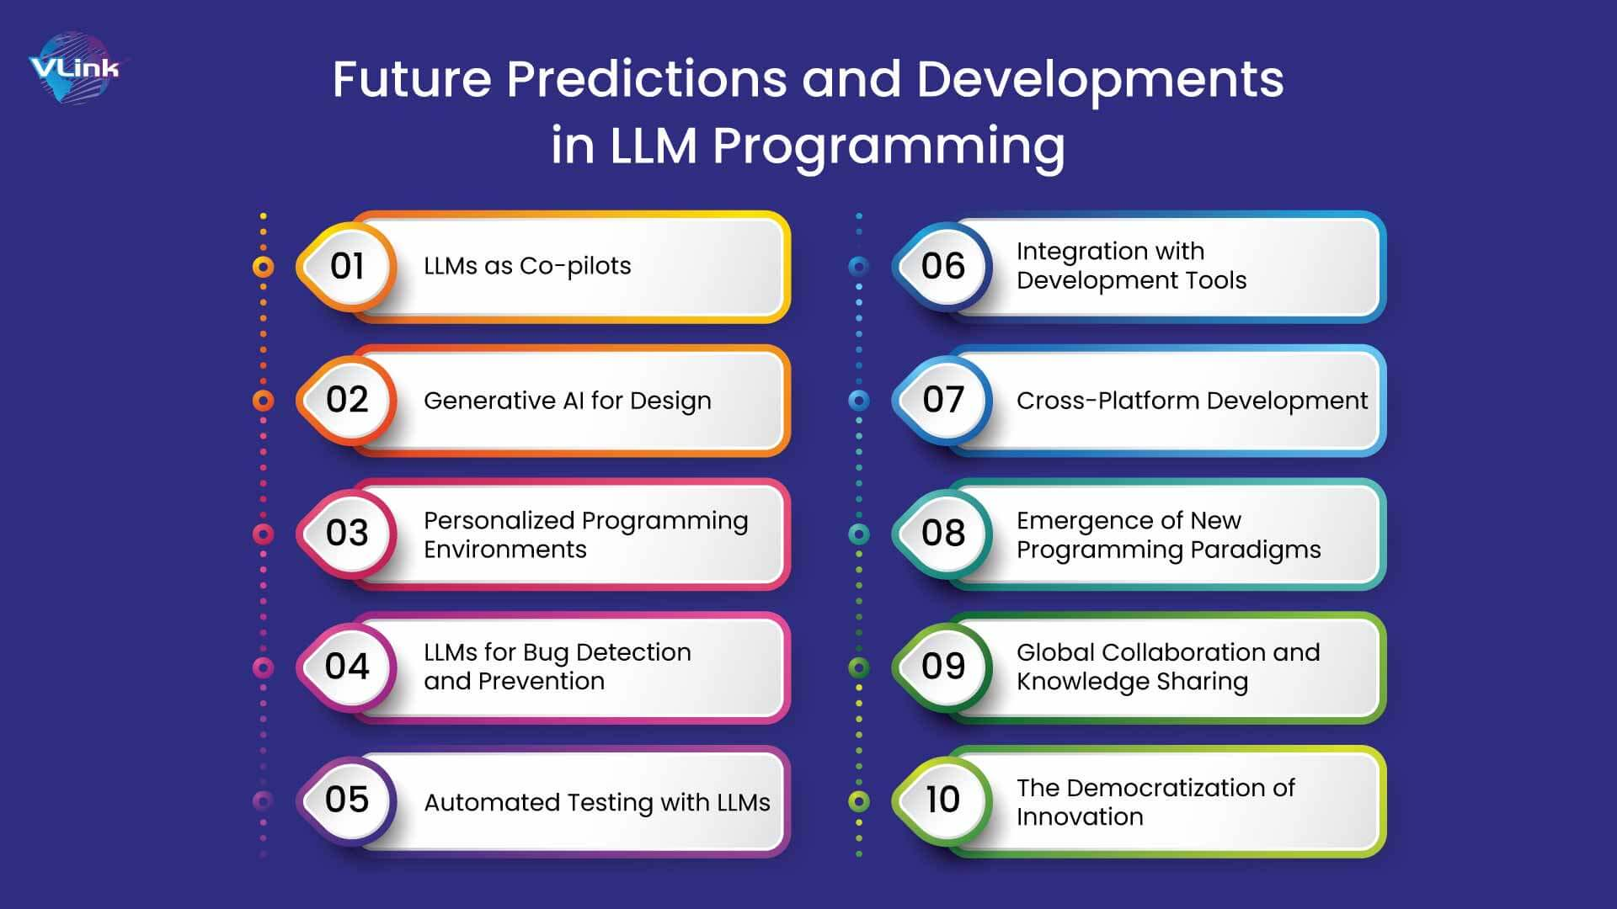
The LLM bit…

Slide 43
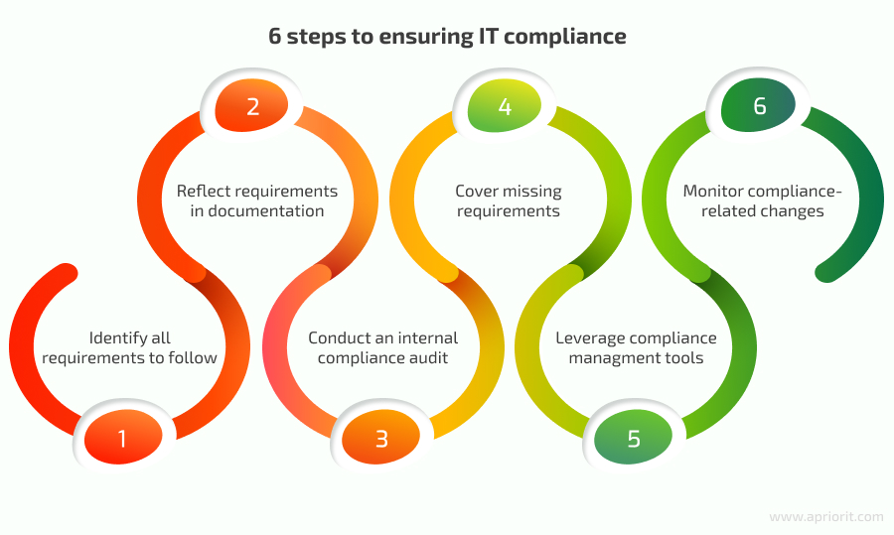
The LLM bit…

Slide 44
Software Configuration Management
The concept of configuration management (CM) was developed to manage changes in large systems.
It handles the control of all product items and changes to those items.
Software Configuration Management (SCM) is applied to software products.
The product items include document, executable software, source code, hardware, and disks.
SCM accrues two kinds of benefits to an organization:
  SCM ensures that development processes are traceable and systematic so that all changes are precisely managed.
  SCM enhances the quality of the delivered system and the productivity of the maintainers.
The objectives of SCM are to:
  • Uniquely identify every version of every software at various points in time.
  • Retain past versions of documentations and software.
  • Provide a trail of audit for all modifications performed.
  • Throughout the software life-cycle, maintain the traceability and integrity of the system changes.
Notes:
Handouts

Slide 45
Software Configuration Management
Projects benefit from effective SCM as follows:
  1. Confusion is reduced and order is established.
  2. To maintain product integrity, the necessary activities are organized.
  3. Correct product configurations are ensured.
  4. Quality is ensured – and better quality software consumes less maintenance efforts.
  5. Productivity is improved, because analysts and programmers know exactly where to find any piece of the software.
  6. Liability is reduced by documenting the trail of actions.
  7. Life cycle cost is reduced.
  8. Conformance with requirements is enabled.
  9. A reliable working environment is provided.
  10. Compliance with standards is enhanced.
  11. Accounting of status is enhanced.
Notes:
Handouts

Slide 46
Brief History
A need for configuration management was originally felt in the aerospace industry in the 1950s.
In the 1970s, large scale computer software began to pose many of those same change management problems.
Software maintenance engineers borrowed configuration management techniques from the aerospace industry to manage software modifications.
In the beginning, punch cards with different colors were used to indicate changes.
In the late 1960s, to indicate changes to the UNIVAC-1100 EXEC-8 operating system, maintenance personnel used “corrective cards.”
At that time, development of operating systems benefited from SCM.
Notes:
Handouts

Slide 47
Brief History
In the 1970s and the 1980s, SCM emerged as a distinct discipline.
the Unix-based software tool Make accepts descriptions of system configurations, and can automatically construct the system from its descriptions.
in the 1980s, delta algorithms based on text matching were developed to enable SCM tools to store just the differences among versions.
Consequently, novel algorithms were developed for efficient storage and retrieval of non-textual objects.
These days SCM systems support the management of evolution of a broad range of software systems that are being modified by a large number of maintenance personnel working in different countries and utilizing a variety of machines.
Notes:
Handouts

Slide 48
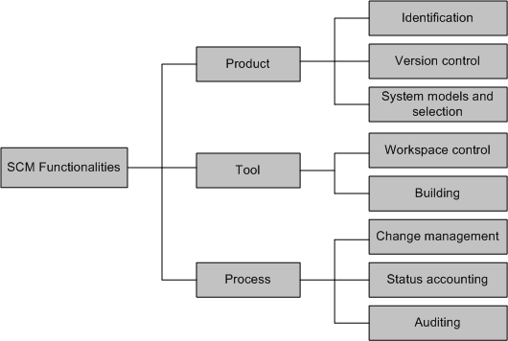
SCM Spectrum of Functionality
Estublier et al. classified the functionalities into three broad areas:
  product,
  tool, and
  Process.
Technical dimension of SCM systems
Notes:
Handouts

Slide 49
SCM Spectrum of Functionality
Identification
The items whose configurations need to be managed are identified in this function.
The identified items include specification, design, documents, data, drawings, source code, executable code, test plan, test script, hardware components, and components of the software development environment, namely, compilers, debuggers, and emulators.
Project plan and customer requirements should also be included.
To accurately identify products, including their configuration and version levels, a schema of names and numbers is designed.
Finally, for all configuration items and systems, a baseline configuration is established.
Notes:
Handouts

Slide 50
SCM Spectrum of Functionality
Version control
To avoid confusion during the process of artifact evolution, a new identifier is assigned to the artifact every time the artifact is modified.
One may be interested in recording a fact that a given artifact fixes a subset of defects found in an earlier release.
The aforementioned kind of relation can be recorded by means of the version control (VC) functionality of SCM by:
  (i) interpreting software artifacts as configuration items, and
  (ii) identifying the relations, if there is any, among the configuration items.
The basic version control idea is to have two separate files: master copies and working copies.
The former is stored in a centralized repository.
Software developers check out working copies from the repository, modify the working copies, and, finally, check in the working copies into the repository.
Checking in a file means committing to the changes made to the working copies.
Notes:
Handouts

Slide 51
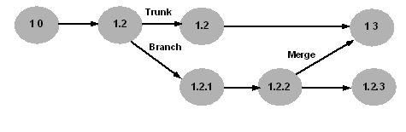
SCM Spectrum of Functionality
Version control
Conflicts can arise if many software developers want to use the same version of a file.
Conflicts can be resolved by means of two techniques: lock-modify-unlock and copy-modify-merge.
Version control must support parallel development by allowing branching of versions.
Consider the scenario: (i) an organization is currently developing the next version of their already released application; and (ii) a report about a major defect is received from the end users.
Now the development group has the option to retrieve the released version and create a branch, as illustrated in Figure, to fix the defect.
The figure illustrates how a file evolves with two branches, where the main path is called trunk. As shown in the figure below, branch changes are incorporated by merging with the trunk.
An evolution of a file with two branches
Notes:
Handouts

Slide 52
SCM Spectrum of Functionality
System models and selections
It is neither efficient nor effective to manage a project file-by-file.
There is a need to support aggregate artifacts so that maintenance personnel can enforce consistency in large projects by means of relationships among artifacts and attributes.
Relationships among artifacts and attributes are captured by developing models which support the idea of software configurations.
Intuitively, a configuration means an aggregate of versionable items.
The general idea of configuration raises a need for enabling users to have selective access to parts and versions of such aggregated artifacts.
By default, SCCS and RCS keep in the workspace the most recent version of the principal variant.
Next, all artifacts that are exceptions to the default placement rule can be explicitly fetched by the user.
Notes:
Handouts

Slide 53
SCM Spectrum of Functionality
Workspace control
An environment that enables the maintainer to make and test the changes in an isolated manner is called workspace.
In an SCM system, software versions are stored in a repository that can not be directly modified. Rather, when a need to modify some files arises, the files are copied into a workspace.
One can realize a workspace in two ways:
  (i) it can be as simple as the home directory of the programmer who wants to modify the files;
  (ii) it can be a complex mechanism such as an integrated development environment and a database.
In general, three basic functions are performed in a workspace:
  • Sandbox: Checked out files are put in a workspace to be freely edited. In addition, it is not necessary to lock the original files in the repository.
  • Building: An SCM system generally stores the differences between successive versions to save space. Therefore, the workspace expands the deltas into full-fledged source files. In addition, the workspace stores the derived binaries.
  • Isolation: Every developer maintains at least one workspace. Therefore, the developer makes modifications to the source code, compiles the files, performs tests, and debugs code without impacting the works of other developers.
Notes:
Handouts

Slide 54
SCM Spectrum of Functionality
Building
Efficiency is a key requirement of SCM systems so that developers can quickly build an executable file from the versioned source files.
Second requirement of SCM systems is that it must enable the building of old versions of the system for recovery, testing, maintenance, or additional release purpose.
Finally, SCM systems must support building of software.
The build process and their products are assessed for quality assurance.
Outputs of the build process become quality assurance records, and the records may be needed for future reference.
The make application on the Unix operating system, originally developed by researchers at Bell Laboratories, is a classical example of a build process.
Commercial SCM systems such as ClearCase continue to rely on variants of make.
Notes:
Handouts

Slide 55
SCM Spectrum of Functionality
Change management
SCM systems must:
  (i) enable users to understand the impact of modifications.
  (ii) enable users to identify the products to which a specific modification applies.
  (iii) provide maintenance personnel with tools for change management so that all activities from specifying requirements to coding can be traced.
In the beginning, CRs were managed in paper form.
However, these days CRs are saved in the SCM repository and are linked with the actual modifications, in addition to being automated.
Notes:
Handouts

Slide 56
SCM Spectrum of Functionality
Accounting
The primary purpose of status accounting is to:
  (i) keep formal records of already existing configurations, and
  (ii) produce periodic reports about the status of the configurations.
  These records:
  - describe the product correctly,
  - are used to verify the configuration of the system for testing and delivery, and
  - maintain a history of change requests, including both the approved ones and the rejected ones.
A history of change request includes the answers to the following questions:
    • Why are changes made?
    • When are the changes made?
    • Who makes the changes?
    • What changes are made?
Status accounting is useful in communicating important details of the project and configuration items to the stakeholders of the project.
Notes:
Handouts

Slide 57
SCM Spectrum of Functionality
Auditing
SCM systems need to provide the following features:
(i) roll back to earlier stable points.
(ii) identify which modifications were performed, why those modifications were performed, and who performed those modifications.
By means of auditing, the organization maintains the integrity of the baselines and release configurations for all products.
Two kinds of audits are performed before a software is released:
  audit for functional configuration: determines whether or not the software satisfies the user requirement specification and the system requirement specification.
  audit for physical configuration: It verifies if the reference and design documents accurately represent the software.
Notes:
Handouts

Slide 58
SCM Spectrum of Functionality
Auditing
Overall, a configuration audit tries to find answers to the following:
  • To what extent are the requirements satisfied by the modified system?
  • Does the software release under consideration reflect the modification requests?
The activities to perform a configuration audit are as follows:
  • Procedures and an audit schedule are defined.
  • The personnel to perform the audits are identified.
  • Established baselines are audited.
  • Audit reports are generated.
Notes:
Handouts

Slide 59
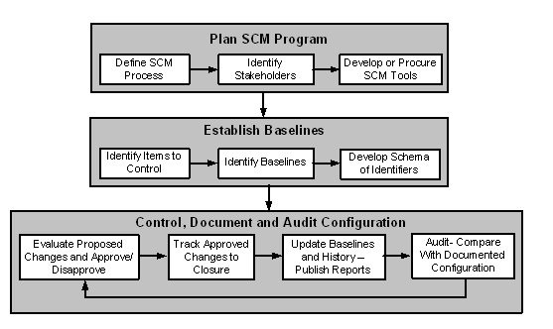
SCM Process
The figure below shows the three major SCM implementation activities:
    planning,
    baseline development, and
    configuration control.
A process for implementing SCM
Notes:
Handouts

Slide 60
SCM Process
Planning
Planning is begun with two activities:
    (i) define the SCM process, and
    (ii) establish procedures.
A key step during planning is the identification of the stakeholders.
The stakeholders in a configuration management are the maintainers, development engineers, sustaining test engineers, quality assurance auditors, users, and the management.
The stakeholders are also known as configuration control board (CCB) members.
Not all changes are reviewed by the board. Rather, small groups review and approve most of the changes.
Therefore, those groups need to be identified in the planning phase.
Various SCM tools are used to maintain configuration history and facilitate the SCM process flow.
Examples of such tools are CVS (concurrent version system) and Clearcase.
Notes:
Handouts

Slide 61
SCM Process
Establishing baseline
Once an SCM program plan is in place, the next step is identification of items (code, data, and documents) that are the subject of configuration control.
After the configuration items identified, a software baseline library is established to make the set of configurable items publicly available.
The library, called repository, is the heart of the SCM system.
The repository has information about all the baselined items.
The process of baseline (or re-baseline for a change) involve the following activities:
  1. Create a snapshot of the current version of the product and its configuration items, and allocate a configuration identifier to the entire configuration.
  2. Allocate version numbers to the configuration items and check in the configuration.
  3. Store the approved authority information as part of meta data in the repository.
  4. Broadcast all the above information to the stakeholders.
  5. To accurately identify the configuration version, design a schema of words, numbers, or letters for common types of configuration items. In addition, project requirements may dictate specific nomenclature.
Notes:
Handouts

Slide 62
SCM Process
Controlling, documenting and auditing
After establishing a baseline, it is important to:
  (i) keep the actual and the documented configuration identical;
  (ii) ensure that the baseline complies with a project’s configuration described in the requirements document.
The aforementioned requirements of a baseline are realized by means of a four-step iterative process illustrated in the Figure below.
A process for implementing SCM
Notes:
Handouts

Slide 63



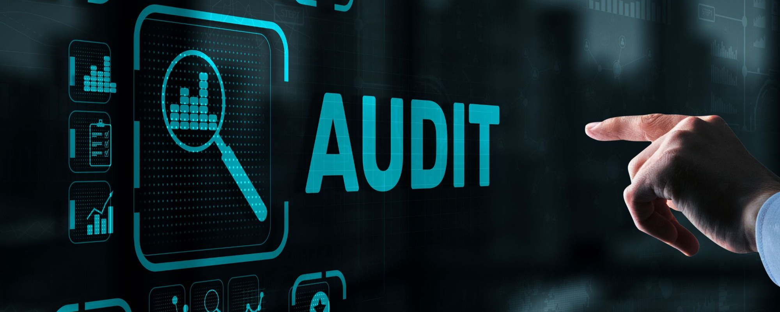

Slide 64
SCM Process
Controlling, documenting and auditing
The stakeholders specified in the SCM plan review and evaluate all changes to the configuration.
After their evaluations, both approvals and disapprovals are documented.
Approved changes are tracked until they are verified .
Next, the appropriate baseline is revised in conjunction with all relevant documents, and reports are generated.
At regular intervals, records and products are audited to verify that:
  • There is acceptable matching between the documented configuration and the actual configuration.
  • The configuration conforms with the requirements of the project.
  • Documentations of all change activities are complete and up-to-date.
The three steps in the cycle, namely, controlling, documenting, and auditing, are repeatedly executed throughout the lifetime of the project.
Notes:
Handouts

Slide 65
Change Request Workflow
A change request (CR), also called a modification request (MR), is a vehicle for recording information about a system defect, requested enhancement, or quality improvement.
Change requests are placed under the control of a change management system.
Change management systems control changes by an automated system in the form of work-flow.
The basic objective of change management is to uniquely identify, describe, and track the status of each requested change.
The objectives of change management are as follows:
  • Provide a common method for communication among stakeholders.
  • Uniquely identify and track the status of each CR. This feature simplifies progress reporting and provides better control over changes.
  • Maintain a database about all changes to the system. This information can be used for monitoring and measuring metrics.
Notes:
Handouts

Slide 66
Change Request Workflow
A change request describes the desires and needs of users which the system is expected to implement.
While describing a CR, two factors need to be taken into account:
  • Correctness of CRs, and
  • Clear communication of CRs to the stakeholders.
The results of interpreting a CR in different ways are as follows:
  • The team carrying out actual changes to the system and the team performing tests may develop contradicting views about the new system’s quality.
  • The changed system may not meet the needs and desires of the end users.
CRs need to be represented in an unambiguous manner, and made available in a centralized repository.
Wide availability of CRs to all the stakeholders is likely to reveal differences in interpretations by different groups.
Notes:
Handouts

Slide 67
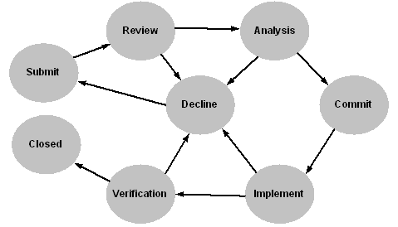
Change Request Workflow
The life-cycle of a CR has been illustrated in the Figure below, by means of a state-transition diagram.
Each state represents a distinct stage in the life-cycle of a CR.
State transition diagram of a CR
Notes:
Handouts

Slide 68
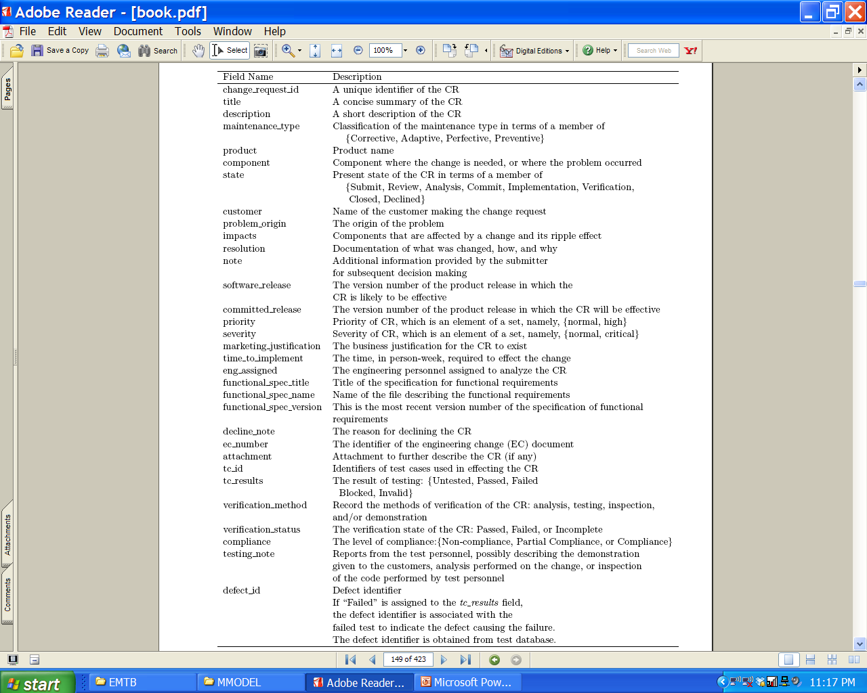
Change Request Workflow
Change request schema field summary
Notes:
Handouts

Slide 69
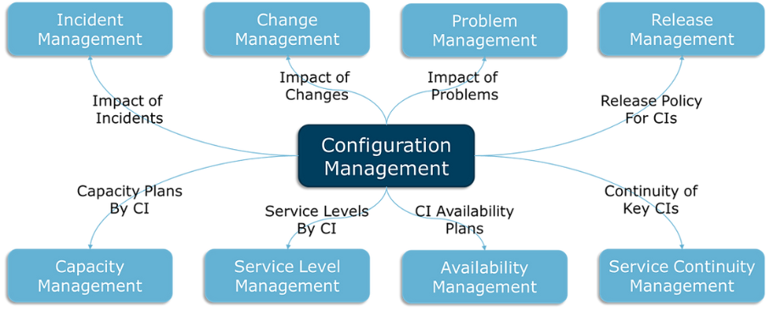
The LLM bit…

Slide 70
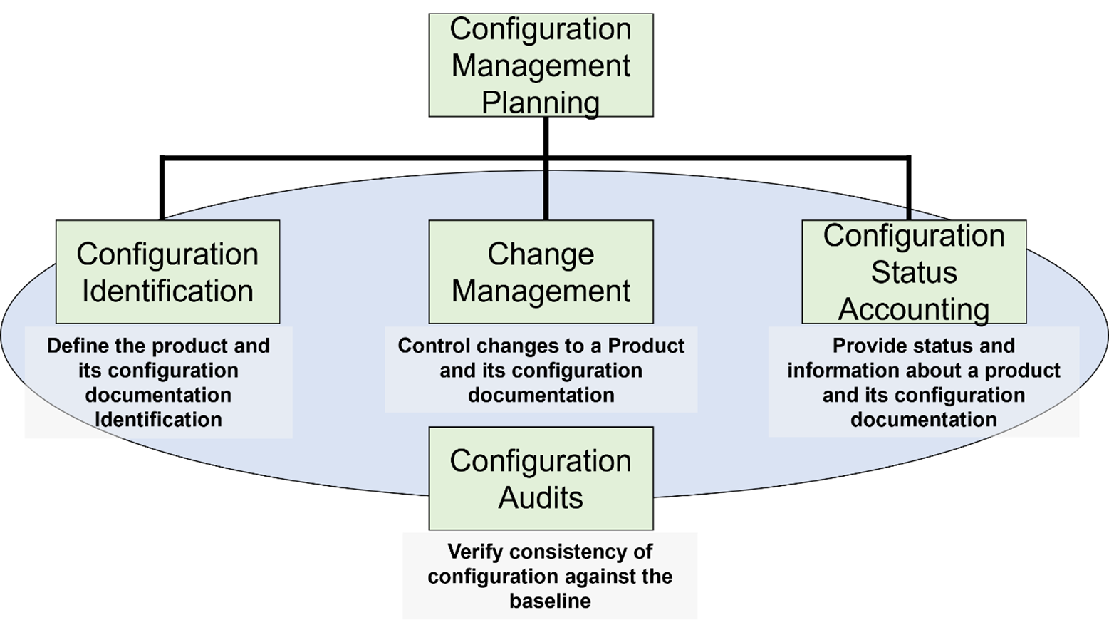
The LLM bit…

Slide 71
Summary
Standards exist to determine the agreed-upon steps to address maintenance and evolution activities in a traceable fashion;
  Overall, following the standards adds structure but also overheads!
  Must be used in context and within reason, tool support exists;
Specific STD phases are already tool-supported/automated (e.g., code review, check-listing, etc.);
Typically, organizations have culture assets already pre setup, validated through experience and domain-specificity (e.g., Leonardo, ESA/AIAA EGOS-MF framework);
Your job is to familiarize with the standard, be prepared to see an instance of it!
LLMs help? Mmm, so and so…

Slide 72

Questions?
Sw. Evolution

